Slide 1

Network+ Guide to Networks 6th Edition
Chapter 13
Troubleshooting Network Problems

Slide 2
Objectives
Describe the steps involved in an effective troubleshooting methodology
Follow a systematic troubleshooting process to identify and resolve networking problems
Document symptoms, solutions, and results when troubleshooting network problems
Use a variety of software and hardware tools to diagnose problems

Slide 3
Troubleshooting Methodology
Proceed logically and methodically
Follow recommended steps
Use experience when necessary
Logical approach benefits
Prevents wasteful, time-consuming efforts
Unnecessary software, hardware replacements

Slide 4
Troubleshooting Methodology (cont’d.)
Troubleshooting steps
Identify problem
Gather information
Identify symptoms
Question users
Determine if anything has changed
Establish theory of probable cause
Question the obvious

Slide 5
Troubleshooting Methodology (cont’d.)
Troubleshooting steps (cont’d.)
Test theory to determine cause
If theory confirmed, determine next steps
If theory not confirmed, establish new theory or escalate
Establish action plan
Implement solution or escalate
Verify full functionality
Implement preventative measures if applicable
Document findings, actions, outcomes

Slide 6
Identify the Problem and Its Symptoms
Ask questions
Answers help identify network problem symptoms
Avoid jumping to conclusions about symptoms
Pay attention to:
Users
System and network behaviors
Error messages
Treat each symptom uniquely

Slide 7
Identify the Problem and Its Symptoms (cont’d.)
Determine the problem’s scope
Find out how many users or network segments are affected
Narrow down time frame during which problem occurred
Benefits of narrowing scope
Eliminate causes, point to others

Slide 8
Identify the Problem and Its Symptoms (cont’d.)
Take time to troubleshoot correctly
Ask specific questions
Filter unrelated user information
Discover time and frequency of problem
May reveal more subtle network problems
Identify affected problem area
Leads to next troubleshooting steps

Slide 9
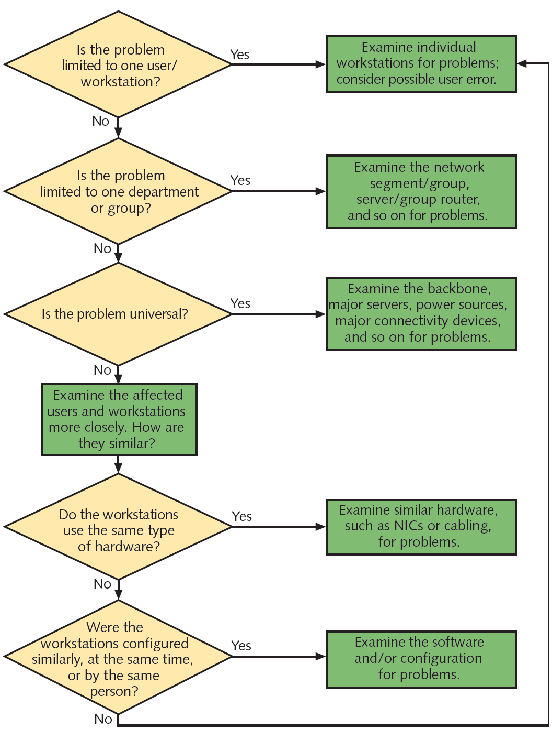
Figure 13-1 Identifying the area affected by a problem
Courtesy Course Technology/Cengage Learning

Slide 10
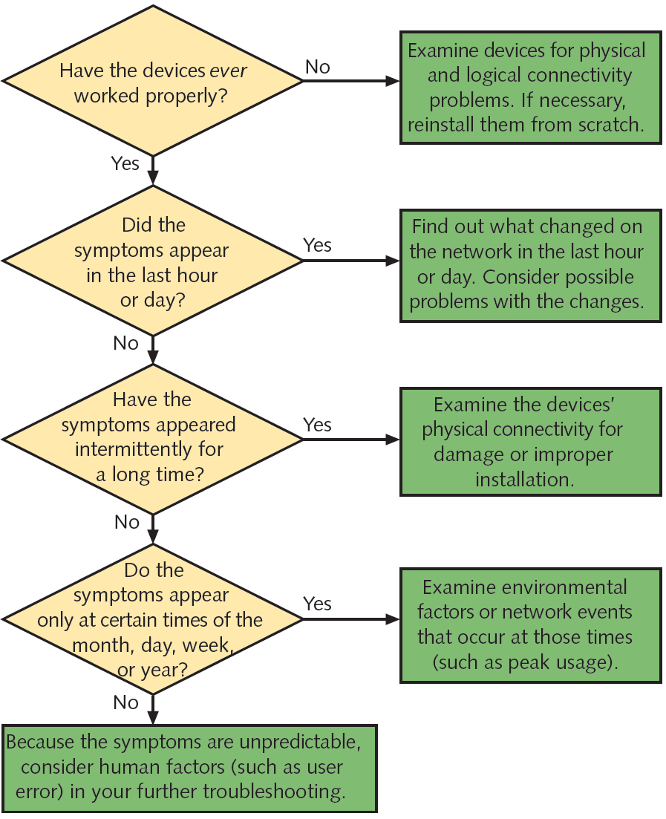
Figure 13-2 Identifying the chronological scope of a problem
Courtesy Course Technology/Cengage Learning

Slide 11
Identify the Problem and Its Symptoms (cont’d.)
Question users
Ensure human error is not source of problem
Watch the user if possible
Use remote desktop software
Ask what appears on the screen
Use methodical approach
Determine if anything has changed
Be aware of recent network changes
Ask questions pinpointing problem resulting from network change

Slide 12
Identify the Problem and Its Symptoms (cont’d.)
Possible actions if network change created problem
Correct problem
Sometimes the best solution
Reverse change
Less risky, less time consuming
Network change records
Track what has changed
Make records available to staff members

Slide 13
Establish a Theory of Probable Cause
Re-create the symptoms
Follow same steps as person reporting symptom
Verify Physical layer connectivity
Cabling and network adapters a common source of problems
Symptoms of physical layer problems
Segment, network lengths exceed standards
Noise
Improper terminations, faulty, loose, or poorly crimped connectors
Damaged cables
Faulty NICs, GBICs, SFPs

Slide 14
Establish a Theory of Probable Cause
Verify Physical layer connectivity (cont’d.)
Diagnosing Physical layer problems
Ask questions
Verify connections between devices
Verify soundness of connection hardware
Verify logical connectivity
Consider error messages
Note changes in operating system or applications
Determine if the problem is repeatable
Find out who is affected by the problem
Narrow down possibilities

Slide 15
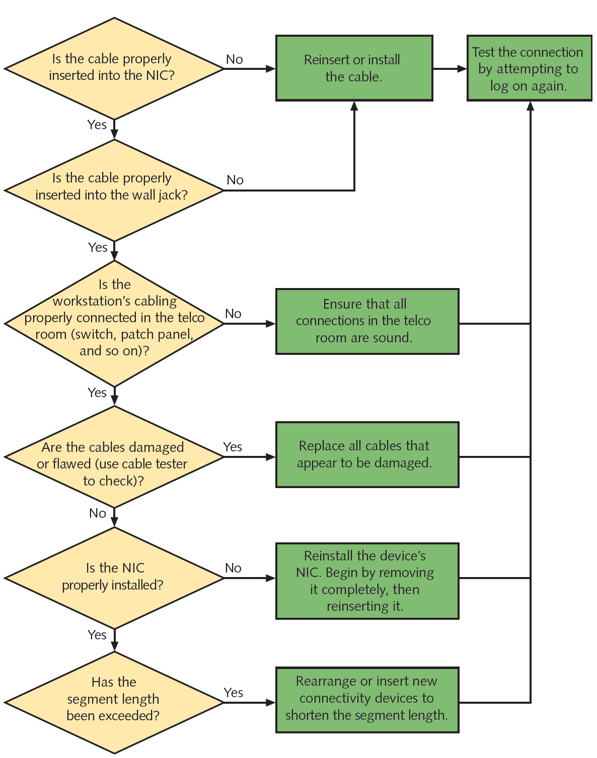
Figure 13-3 Verifying physical connectivity
Courtesy Course Technology/Cengage Learning

Slide 16
Test the Theory to Determine Cause
Test Physical layer theories
Complicated problems require effort and analysis
Example approaches
Use a cable testing tool
Check to make sure NIC is seated firmly in slot
Use wireless analyzer
Follow cables to verify physical connectivity
Exchange suspect component with a known good one
Try different port, data jack, or SFP module

Slide 17
Test the Theory to Determine Cause (cont’d.)
Test logical connectivity theories
Testing theory may end up solving the problem
Example approaches
View switch configuration to determine which nodes are included in VLANs
Investigate user permissions
Examine NIC configuration
Ensure routing table includes valid entries
Use tools such as ping, netstat, route, traceroute
Check wireless client settings

Slide 18
Test the Theory to Determine Cause (cont’d.)
Escalate if necessary
Ask colleague with more experience or knowledge
Help desk analysts
Proficient in basic workstation, network troubleshooting
First-level support
Network specialist
Second-level support
Help desk coordinator
Third-level support personnel
Follow escalation procedures

Slide 19
Establish a Plan of Action to Resolve the Problem
Consider how solution affects users, network functionality
Scope
Assess solution’s scope before implementing
Wait if not an emergency
Trade-offs
Solution may restore functionality for one user group
But may remove functionality for others

Slide 20
Establish a Plan of Action to Resolve the Problem (cont’d.)
Security
Be aware of security implications
Inadvertent removal of network access, resource privileges
Before upgrade, patch installation
Understand access changes for authorized, unauthorized users

Slide 21
Establish a Plan of Action to Resolve the Problem (cont’d.)
Scalability of solution
Position network for future additions, enhancements
Temporary fix organization will outgrow
Cost
Weigh options carefully
Consider addressing poor network performance areas separately

Slide 22
Establish a Plan of Action to Resolve the Problem (cont’d.)
Use vendor information
Manufacturer documentation
Free online troubleshooting information
Searchable databases
Sophisticated web interfaces for troubleshooting equipment
Vendor’s technical phone support
Consult with others within, outside your organization

Slide 23
Implement the Solution or Escalate as Necessary
Solution implementation
Time required may be minimal or long
Requires foresight, patience
Use methodical and logical approach
Leads to efficient correction process
Problem causing catastrophic outages should be solved as quickly as possible
Follow series of steps
Implement a safe, reliable solution
Large-scale fixes
Roll out changes in stages

Slide 24
Verify Full System Functionality
Verify problem solution is complete
Type of testing depends on solution
Also area affected by problem
May not be able to test solution immediately
Determine how and why solution is successful
Evaluate effects on users and functionality
Consider how similar problems may be prevented in the future

Slide 25
Document Findings, Actions, and Outcomes
Necessary to record:
Problem symptoms and cause(s)
Solution(s)
Justification for recording
Impossible to remember each incident’s circumstances
Job changes
Use centrally located database
Accessible to all networking personnel

Slide 26
Document Findings, Actions, and Outcomes (cont’d.)
Call tracking system (help desk software)
User-friendly, graphical
Prompts for problem information
Assigns unique problem number
Highly customizable
If not available, use simple electronic form
Supported services list document
Lists all supported service, software and contacts
Follow-up with user who reported problem

Slide 27
Document Findings, Actions, and Outcomes (cont’d.)
Notify others of changes
Record resolution in call tracking system
Alert others about problem, solution
Notify others of network changes made
Change management system
Process or program
Means of documenting network changes
Minor modifications need not be recorded
Example: user password reset

Slide 28
Troubleshooting Tools
Utilities help troubleshoot network problems
Ping
Specialized tools
Specifically designed to analyze, isolate network problems
Simple continuity testers
Protocol analyzers
Tool selection dependencies
Problem being investigated
Network characteristics

Slide 29
Tone Generator and Tone Locator
Ideal situation
Telecommunications closet ports, wire terminations labeled properly
Reality
Telecommunications closet disorganized, poorly documented
Tone generator (toner)
Small electronic device
Issues signal on wire pair

Slide 30
Tone Generator and Tone Locator (cont’d.)
Tone locator (probe)
Emits tone when electrical activity detected
Probe kit
Generator and locator combination
Testing requires trial and error
Used to determine where wire pair terminates
Not used to determine cable characteristics

Slide 31
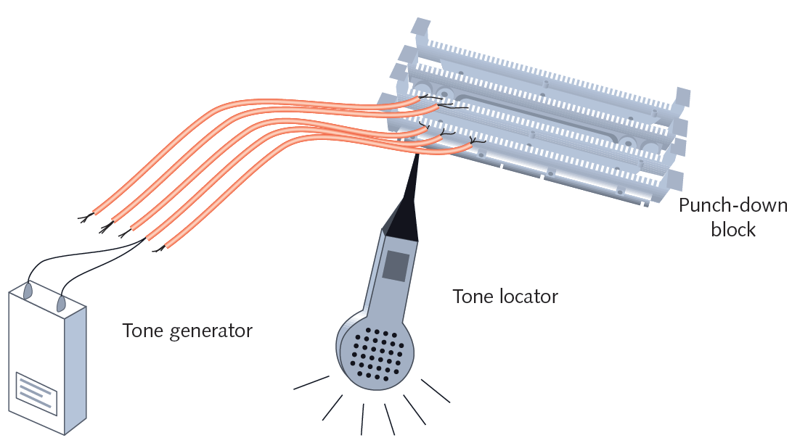
Figure 13-4 Use of a tone generator and tone locator
Courtesy Course Technology/Cengage Learning

Slide 32
Multimeter
Specialized tools used to test cables for faults
Isolate problems with network cables
Multimeter
Measures electric circuit characteristics
Resistance and voltage
Voltmeter
Measures voltage of an electric current
Voltage creates signals over network wire

Slide 33
Multimeter (cont’d.)
Resistance
Fundamental wire property
Depends on wire’s molecular structure, size
Measured in ohms using ohmmeter
Impedance
Resistance contributing to controlling signal
Measured in ohms
Telltale factor for ascertaining where cable faults lie
Some required for proper signal transmission and interpretation

Slide 34
Multimeter (cont’d.)
Multimeter
Single instrument for measuring impedance, resistance, voltage on a wire
Has several uses
Sophistication, features, and costs vary

Slide 35
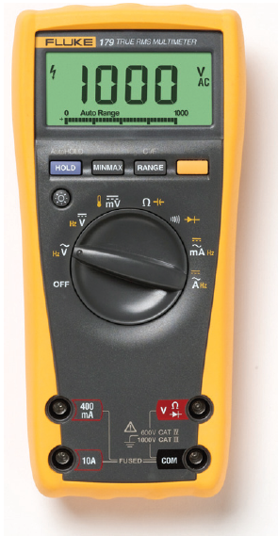
Figure 13-5 A multimeter
Courtesy Fluke Networks

Slide 36
Cable Continuity Testers
Cable checkers (continuity testers, cable testers)
Tests whether cable carries signal to destination
Copper-based cable tester
Consists of two parts
Base unit generates voltage
Remote unit detects voltage
Series of lights, audible tone
Used to signal pass/fail

Slide 37
Cable Continuity Testers (cont’d.)
Some continuity testers verify UTP, STP wires paired correctly
Not shorted, exposed, crossed
Fiber optic continuity tester
Issues light pulses on fiber
Determines whether pulses reach other end
Test all cables to ensure meeting network’s required standards
Homemade or purchased
Offer convenience: portable, lightweight, low cost

Slide 38
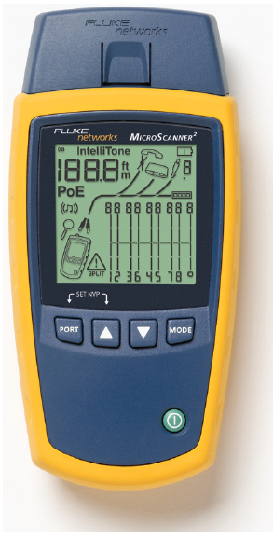
Figure 13-6 Cable continuity tester
Courtesy Fluke Networks

Slide 39
Cable Performance Testers
Determines if cable carrying current
Continuity testers versus performance testers
Differ in sophistication and price
Performance tester accomplishes same tests
Can also perform additional tasks
TDR (time domain reflectometer)
Included with sophisticated performance testers
Issue signal, measures signal bounce back
Indicates distance between nodes
Indicates whether terminators properly installed, functional

Slide 40
Cable Performance Testers (cont’d.)
Fiber-optic connections testers
Use OTDRs (optical time domain reflectometers)
Transmit light-based signals of different wavelengths over fiber
OTDRs
Measure fiber length
Determine faulty splice locations, breaks, connectors, bends
Measure attenuation over cable
Expensive

Slide 41
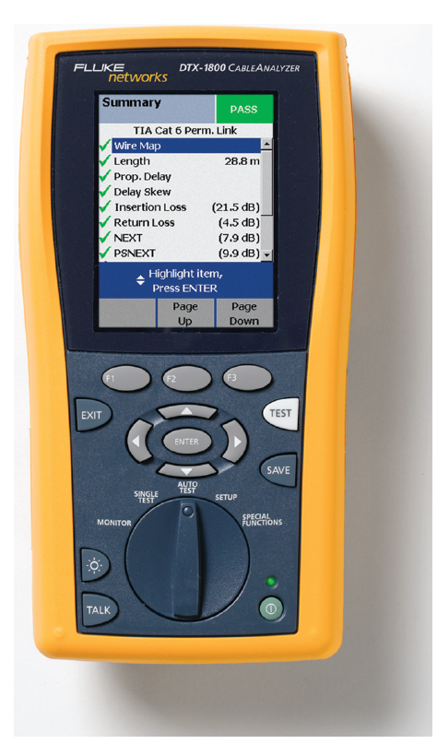
Figure 13-7 A high-end cable performance tester
Courtesy Fluke Networks

Slide 42
Voltage Event Recorders
Voltage event
Any condition where voltage exceeds or drops below predefined levels
Voltage event recorder
Collects data about power quality
Downloads data to workstation
Analyzed by software
Cost: up to $5000

Slide 43
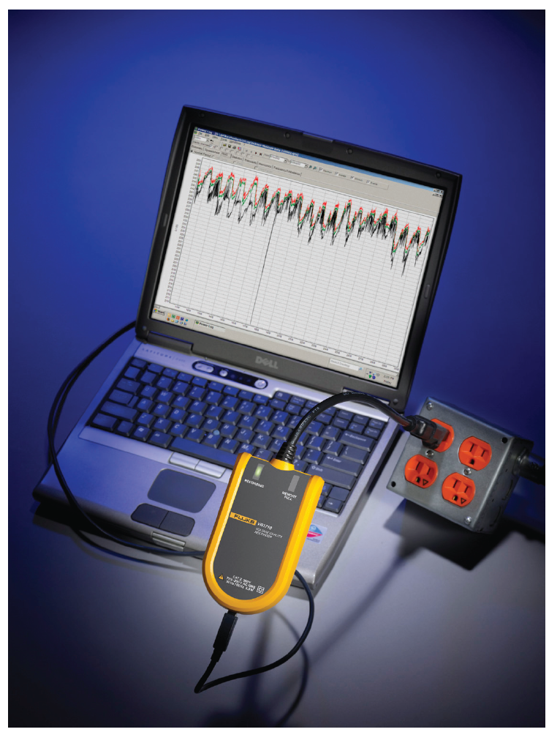
Figure 13-8 Voltage event recorder
Courtesy Fluke Networks

Slide 44
Butt Set
Lineman’s handset, telephone test set
Butt into telephone conversation
Rugged, sophisticated telephone
Uses
Determine if line functioning (detects dial tone)
Receives signal
Picks up noise affecting signal
Sophisticated butt sets
Perform rudimentary cable testing

Slide 45
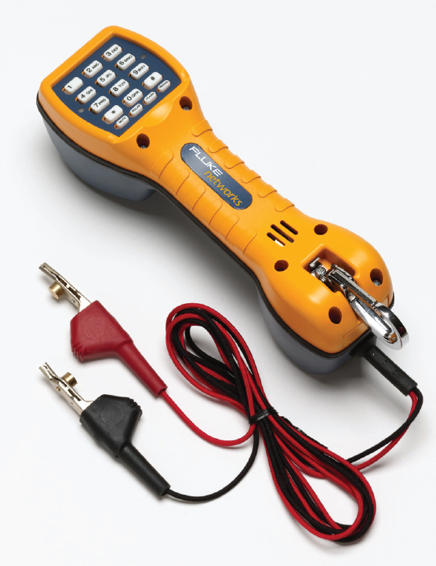
Figure 13-9 Butt set
Courtesy Fluke Networks

Slide 46
Network Monitors
Software-based tool
Continually monitors network traffic from server, workstation attached to network
Interprets up to Layer 3
Determines protocols passed by each frame
Cannot interpret frame data
Included in NOS
Microsoft’s Network Monitor
Tools developed by other software companies
Purchase or free download

Slide 47
Network Monitors (cont’d.)
Network adapter
Must support promiscuous mode
Common terms for abnormal data patterns, packets
Local collisions
Late collisions
Runts
Giants
Jabber
Negative frame sequence checks
Ghosts

Slide 48
Protocol Analyzers
Protocol analyzer (network analyzer)
Captures traffic, analyzes frames
Typically to Layer 7
Variety of protocol analyzer software available
Wireshark
Same features as network monitor
Includes additional features
Generates traffic to reproduce network problem
Sniffer (packet sniffer)
Older term referring to hardware device

Slide 49
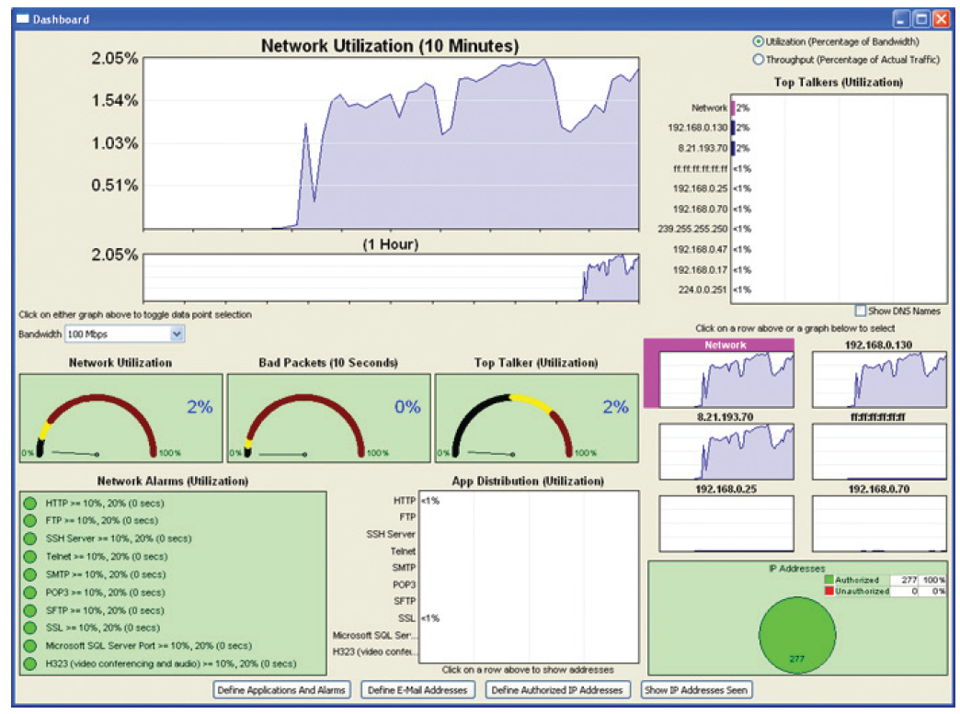
Figure 13-10 Traffic captured by a protocol analyzer
Courtesy Fluke Networks

Slide 50
Protocol Analyzers (cont’d.)
Offers versatility in information type, depth
Can collect more information than can be reasonably processed
Set filters on gathered data
Before using network monitor or protocol analyzer:
Learn what network traffic normally looks like
Capture data for time period on regular basis
Establish a baseline to compare with future analyses

Slide 51
Wireless Network Testers
Tools containing wireless NICs, running wireless protocols
Workstation wireless network connection properties
Shows little about wireless environment
Connection duration, signal speed and strength, number of packets exchanged
Only applies to one workstation
Programs scan for wireless signals
Discover access points, wireless stations transmitting

Slide 52
Wireless Network Testers (cont’d.)
Spectrum analyzer
Tool to assess wireless signal quality
Hardware instruments for wireless network testing
Typically more portable than workstation with software tools
Preinstalled with network analysis tools
Accessible from simple, graphical interface
Contain powerful antennas

Slide 53
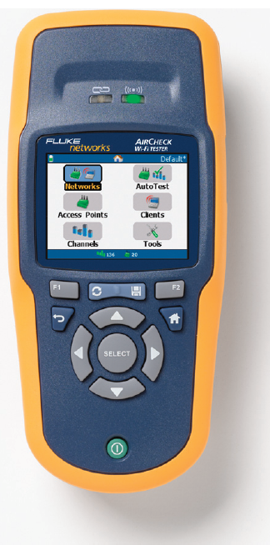
Figure 13-11 Wireless network testing tool
Courtesy Fluke Networks

Slide 54
Summary
Methodical, logical troubleshooting methodology
Key to solving network problems
Troubleshooting tools
Tone generator, tone locator
Multimeters
Cable continuity testers
Cable performance tester
Voltage event recorder
Butt set
Network monitors and protocol analyzers
Wireless network testing tools

